Slide 1

MCP - Model Context Protocol
By

Slide 2
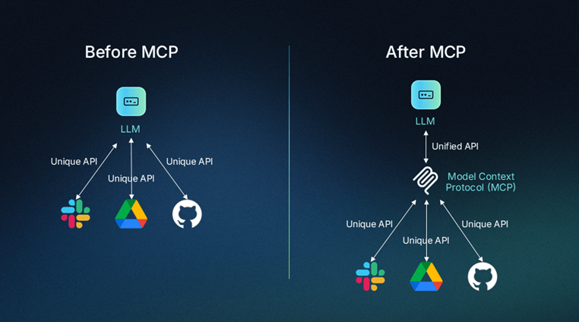
MCP – Model Context Protocol
Model Context Protocol (MCP) is a standard protocol that allows AI models to discover and use external tools with consistent schemas and outputs.

Slide 3
Before MCP
GitHub SDK response
{
"repo_name": "langgraph",
"stars": 12000
}
Before MCP – Integration Problems
Before MCP, when an AI app integrates multiple tools:
Each tool has its own SDK
Each SDK returns different response formats
Example
Suppose your AI agent connects to:
GitHub
Slack
Database
Slack SDK response
{
"channel": "general",
"message_count": 45
}
GitHub SDK → JSON
/
AI App ------- Slack SDK → Dict
\
Database SDK → Tuple
Problems
Different SDKs
Different authentication methods
Different response formats
Extra parsing logic in AI app
Hard to scale when tools increase
Database query response
[
("Prudvi", 32),
("Ravi", 28)
]
Now your AI application must:
Parse each response
Convert it into a standard format
Feed it to the LLM

Slide 4
After MCP
Git Repo output
{
"tool_name": "get_repo_info",
"result": {
"name": "langgraph",
"stars": 12000
}
}
After MCP – Standardized Interface is given.
What MCP Standardizes?
MCP standardizes three things:
Tool discovery - What tools are available?
Tool Input schema
Tool Output format - Structured responses returned to the model.
Slack output
{
"tool_name": "get_slack_messages",
"result": {
"channel": "general",
"count": 45
}
}

Slide 5
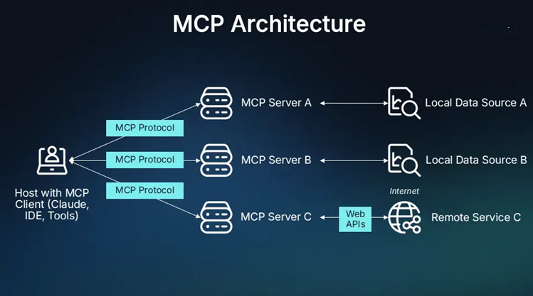
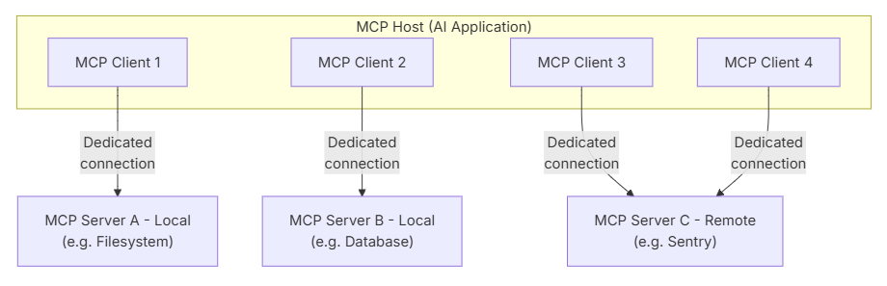
MCP Architecture
The key participants in the MCP architecture are:
MCP Host: The AI application that coordinates and manages one or multiple MCP clients
MCP Client: A component that maintains a connection to an MCP server and obtains context from an MCP server for the MCP host to use
MCP Server: A program that provides context to MCP clients

Slide 6
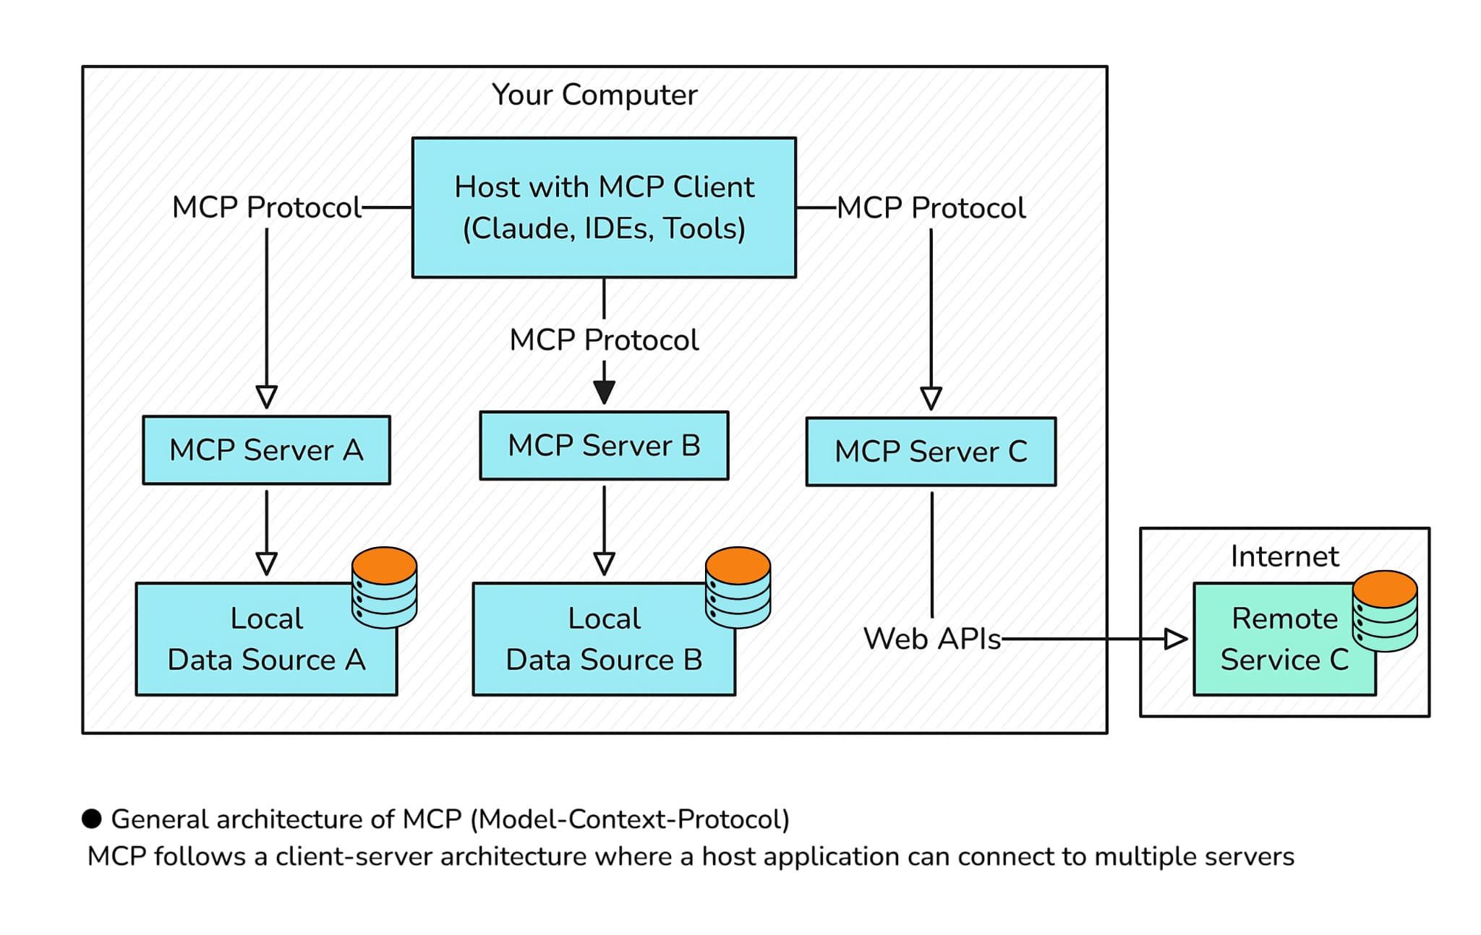
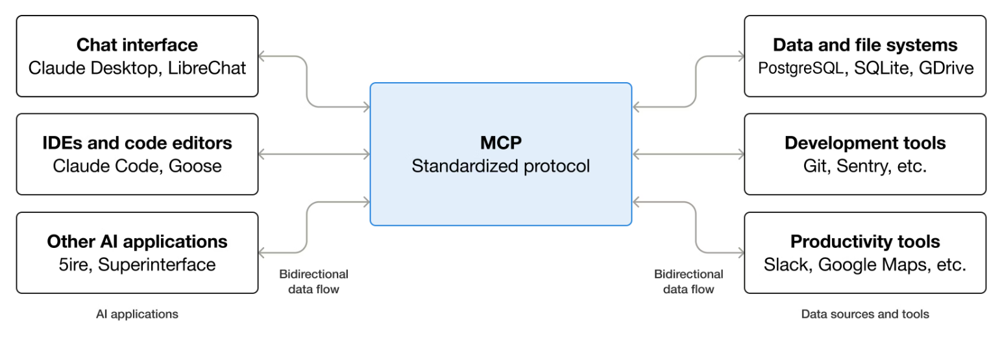
MCP Components
MCP (Model Context Protocol) is an open-source standard for connecting AI applications to external systems.

Slide 7
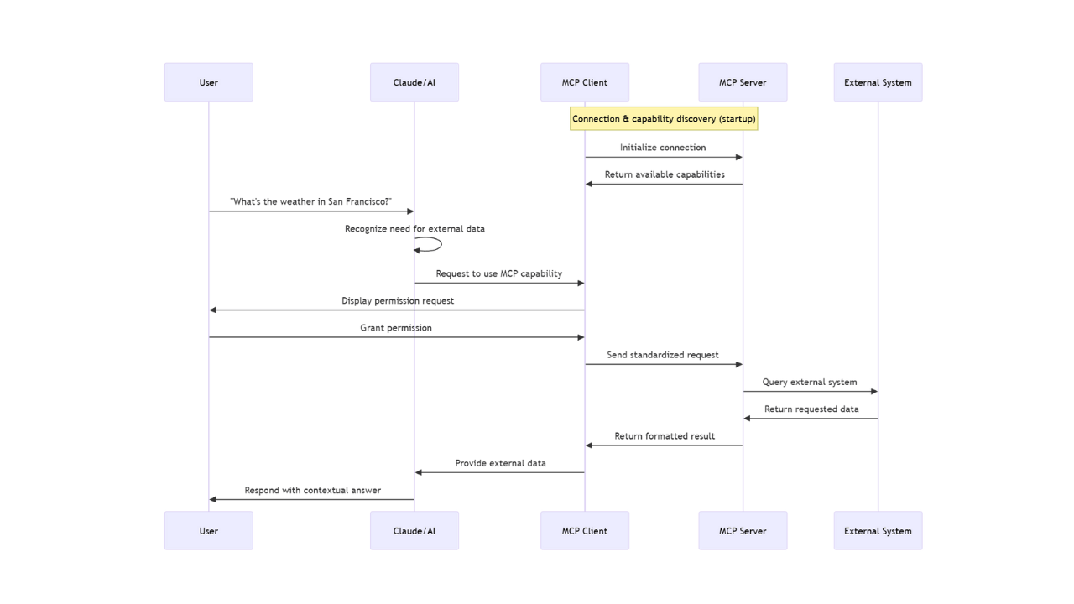
MCP Flow

Slide 8
MCP Host
MCP Host (Coordinator / Brain)
What it is: The AI application that:
Runs the LLM
Decides when to call MCP clients
Injects retrieved context into the prompt
Example:
ChatGPT Desktop
Claude Desktop
Custom AI app built with LangChain / LangGraph
MCP Host
User asks: "Summarize my report"
Decides: "I need file data"
Calls MCP client
Feeds file content to LLM
Produces final answer
End-to-End Flow (Step by Step)
User
↓
MCP Host (AI App)
↓ decides it needs files
MCP Client
↓ MCP request
MCP Server (filesystem)
↓ file contents
MCP Client
↓
MCP Host
↓ LLM reasoning
Final Answer

Slide 9
MCP Client (Connector)
What it is:
A component inside the AI app that connects to the MCP server, sends requests, and receives context.
Example: filesystem MCP client
Maintains a persistent connection (stdio / HTTP / WebSocket)
Translates AI requests → MCP calls
MCP Client
connect to filesystem MCP server
request read_file("report.pdf")
receive file contents
The client is a bridge, not the brain.

Slide 10
MCP Server (Context Provider)
What it is: A program that provides context to MCP clients and exposes resources (files, DBs, APIs) via MCP.
Types of MCP Server:
MCP Server can be BOTH local or remote.
Local MCP Server
Runs on your machine
Example: Filesystem MCP Server
Provides:
list_files(path)
read_file(path)
Use case: access local files
Remote MCP Server
Runs on another machine / cloud
Example: GitHub MCP Server, Database MCP Server
Provides:
get_repo()
list_prs()
query_db()
Use case: access remote services
Key point: MCP Server never talks to the LLM directly — whether local or remote.
Notes:
https://github.com/github/github-mcp-server/blob/main/docs/installation-guides/install-claude.md

Slide 11
MCP Server- Features
Servers provide functionality through three building blocks / primitives
Feature | Explanation | Examples | Who controls it
Tools | Functions that your LLM can actively call, and decides when to use them based on user requests. Tools can write to databases, call external APIs, modify files, or trigger other logic. | Search flights Send messages Create calendar events | Model
Resources | Passive data sources that provide read-only access to information for context, such as file contents, database schemas, or API documentation. | Retrieve documents Access knowledge bases Read calendars | Application
Prompts | Pre-built instruction templates that tell the model to work with specific tools and resources. | Plan a vacation Summarize my meetings Draft an email | User

Slide 12
MCP Server- Features
Method | Purpose | Returns
tools/list | Discover available tools | Array of tool definitions with schemas
tools/call | Execute a specific tool | Tool execution result
resources/list | List available direct resources | Array of resource descriptors
resources/templates/list | Discover resource templates | Array of resource template definitions
resources/read | Retrieve resource contents | Resource data with metadata
resources/subscribe | Monitor resource changes | Subscription confirmation
prompts/list | Discover available prompts | Array of prompt descriptors
prompts/get | Retrieve prompt details | Full prompt definition with arguments
Host
MCP server
Tools
/list
/call
MCP Client
Resources
/list
/read
MCP Client
Prompts
/list
/get

Slide 13
MCP Layers
MCP layers exist to communicate between the MCP Client and MCP Server.
Data layer: Defines the JSON-RPC based protocol for client-server communication, including lifecycle management(initialize and notification), and core primitives, such as tools, resources, prompts and notifications.
Lifecycle management: Handles connection initialization, capability negotiation, and connection termination between clients and servers
Server features: Enables servers to provide core functionality including tools for AI actions, resources for context data, and prompts for interaction templates from and to the client
Client features: Enables servers to ask the client to sample from the host LLM, elicit input from the user, and log messages to the client
Utility features: Supports additional capabilities like notifications for real-time updates and progress tracking for long-running operations
Transport layer: Defines the communication mechanisms and channels that enable data exchange between clients and servers, including transport-specific connection establishment, message framing, and authorization.
Conceptually the data layer is the inner layer, while the transport layer is the outer layer.

Slide 14
Data Layer
The data layer implements a JSON-RPC 2.0 based exchange protocol that defines the message structure and semantics.
Supports bi-directional communication
JSON RPC - Tools list Response
{
"jsonrpc": "2.0",
"id": 2,
"result": {
"tools": [
{
"name": "calculator_arithmetic",
"title": "Calculator",
"description": "Perform mathematical calculations",
"inputSchema": {
"type": "object",
"properties": {
"expression": {
"type": "string",
"description": "Mathematical expression to evaluate"
}
},
"required": ["expression"]
}
}
]
}
}
JSON-RPC - Tools list Request
{
"jsonrpc": "2.0",
"id": 2,
"method": "tools/list"
}

Slide 15
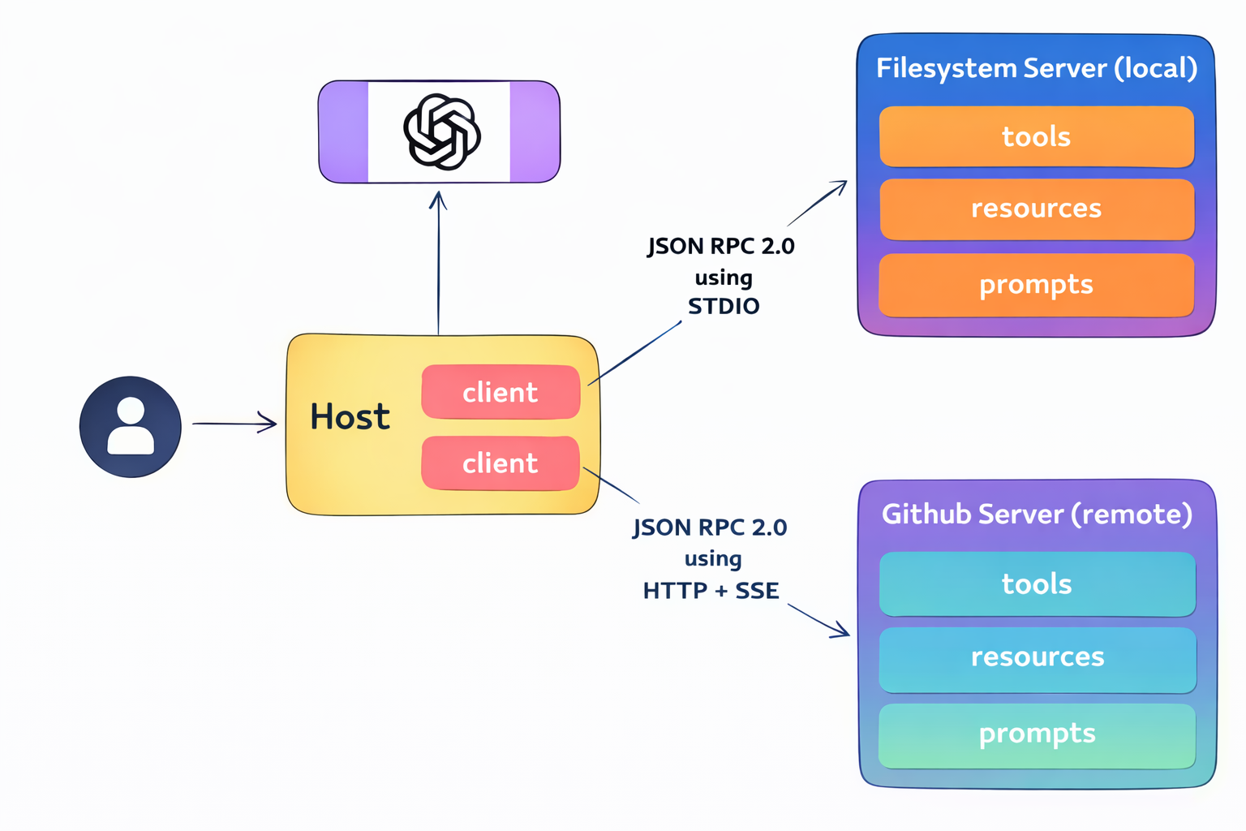
Transport Layer
MCP supports two transport mechanisms:
Stdio transport: (local Server)
Uses standard input/output streams for direct process communication between local processes on the same machine, providing optimal performance with no network overhead.
The host launches the server as a sub process on the same machine and client writes the JSON-RPC msgs to server’s STDIN and server reads the msgs and process and writes responses to STDOUT
Streamable HTTP transport: (Remote Server)
Uses HTTP POST for client-to-server messages by reaching server running anywhere with optional Server-sent Events(SSE) for streaming.
This transport enables remote server communication and supports standard HTTP authentication methods including bearer tokens, API keys, and custom headers.
MCP recommends using OAuth to obtain authentication tokens.

Slide 16
Connect to local MCP servers
Claude Desktop with local MCP servers to enable file system access, to interact with files on your computer, create new documents, organize folders, and search through your file system—all with your explicit permission for each action.
Prerequisites
Claude Desktop: Download and install Claude Desktop for your operating system.
Node.js : The Filesystem Server and many other MCP servers require Node.js to run. download it from nodejs.org.
Goto Claude Desktop, In the Settings window, navigate to the “Developer” tab in the left sidebar. Click the “Edit Config” button to open the configuration file and add below or use connectors and Browse and add the “FileSystem”
{
"mcpServers": {
"filesystem": {
"command": "npx",
"args": [
"-y",
"@modelcontextprotocol/server-filesystem",
"C:\\Users\\username\\Desktop",
"C:\\Users\\username\\Downloads"
]
}
}
}
Note: After saving the configuration file, completely quit Claude Desktop and restart it.
Understanding the Configuration
"filesystem": A friendly name for the server that appears in Claude Desktop
"command": "npx": Uses Node.js’s npx tool to run the server
"-y": Automatically confirms the installation of the server package
"@modelcontextprotocol/server-filesystem": The package name of the Filesystem Server
The remaining arguments: Directories the server is allowed to access
Notes:
Other local server is Manim to generate educational videos. https://github.com/abhiemj/manim-mcp-server
To know the path of manim : in cmd where manim
"mcpServers": {
"manim-server": {
"command": "C:\\Users\\ASUS\\AppData\\Local\\Programs\\Python\\Python312\\python.exe",
"args": [
"H:\\01_Training\\ContentSlides_AgenticAI\\Code\\MCP\\Local_manim-mcp-server\\src\\manim_server.py"
],
"env": {
"MANIM_EXECUTABLE": "C:\\Users\\ASUS\\AppData\\Local\\Programs\\Python\\Python312\\Scripts\\manim.exe"
},
"transport": "stdio",
"type": null,
"cwd": null,
"timeout": null,
"description": null,
"icon": null,
"authentication": null
},

Slide 17
Connect to Remote MCP servers
We can connect to different MCP servers supported. Like Huggingface, GoogleDrive and github etc.
Search for respective MCP server and follow guidelines to add the MCP server to your host application like VSCode, Cursor, Claude Desktop etc.
Works only with Pro plan currently.

Slide 18
FastMCP Vs MCP SDK
MCP is a protocol (set of rules). Writing servers from scratch is complex, so we use libraries.
Two main options are:
MCP SDK (official library by Anthropic)
FastMCP (simplified abstraction)
Evolution of MCP Libraries
MCP was introduced by Anthropic in 2023.
The problem with MCP SDK was too boilerplate-heavy.
FastMCP (by Jeremiah Lowin who built prefect like airflow) simplified it, like Keras simplified TensorFlow.
FastMCP was later integrated into the SDK but also exists independently.
Key points:
SDK had sub-libraries (server, client, CLI).
FastMCP became the developer-friendly choice.
Current State of Libraries
MCP SDK with its tools.
FastMCP 2.0 has been built as an independent library rather with MCP SDK, simpler option.
pip install fastmcp
Notes:
FastMCP lets you take your existing FastAPI app and turn it into an MCP server without rewriting your endpoints:
# app.py
from fastapi import FastAPI
app = FastAPI()
@app.get("/hello")
def hello():
return {"message": "Hello World"}
# main.py
from fastmcp import MCP
from app import app # your existing FastAPI app
# wrap FastAPI app into an MCP server
mcp = MCP(app)
if __name__ == "__main__":
mcp.run(transport="http", host="0.0.0.0", port=8000)

Slide 19
Custom Local MCP servers
pip install uv
# Create a new directory for our project
uv init mcp_local_server
cd mcp_local_server
# Create virtual environment and activate it
uv venv
.venv\Scripts\activate
# Install dependencies
uv add fastmcp
Fastmcp version
#To test the server launches MCP inspector
uv run fastmcp dev main.py
#To run the server
uv run fastmcp run main.py
#Add the server to claude desktop
uv run fastmcp install claude-desktop main.py
In config file try give complete uv path for that use
where uv and copy the path in config file

Slide 20
Custom Remote MCP servers
1. Steps to Create a Remote MCP Server
Install dependencies
pip install uv
uv add fastmcp
Setup project
Create a folder → open in VS Code.
Initialize with uv init .
Write server code (main.py)
Tools: write your own tools(Async)
Key difference from local server:
Local → mcp.run() (default: stdio transport).
Remote → use transport = HTTP with host 0.0.0.0 and a defined port.
4. Run server
fastmcp run main.py --transport http --host 0.0.0.0 --port <number>
5. Debug with MCP Inspector
uv run fastmcp dev main.py
Select transport: streamable http.
Check tools & resources.
Main.py at server : Aiosqlite and all tools definition should be async

Slide 21
Custom Remote MCP servers
3. Deployment with Fast MCP Cloud, need gitRepo
Push code to GitHub.
git init,
git add .
git commit -m "initial commit".
Add remote & push:
git remote add origin <url>
git push origin master
Go to fastmcp.cloud.
Connect GitHub account.
Select repository → Deploy.
Set entry point (main.py).
Optional: change server name, discoverability.
Take api_keys from profile icon and pass it as bearer token
3. Once deployed → server URL generated → shareable.
4. Using Remote MCP Server with Claude Desktop
Go to Settings → Connectors → Add Custom Connector.
Provide server name + URL.
Works only with Pro plan currently.
Notes:
Logged in to fastmcp cloud using github credentials

Slide 22
Custom MCP client
Set Up Environment
Install required packages:
langchain
langchain-mcp-adapters or can use fastmcp client
langchain-google-genai (or OpenAI)
streamlit (optional UI)
Configure Remote MCP Server
Define MCP server metadata:
Server name
Transport type
MCP endpoint URL
Auth headers (Bearer token if required)
SERVERS = {
"expense_remote": {
"transport": "streamable_http",
"url": "<mcp_url>", #use deployed mcp server in fastmcp cloud
"headers": {"Authorization": "Bearer <token>"}
}
}
User → LLM → MCP Tool → Tool Result → LLM → Final Answer
MultiServerMCPClient connects to the remote server URL.
get_tools() fetches the available tools from the remote server.
ainvoke sends a tool call over HTTP and waits for the response.
SERVERS = {
"expense_local": {
"transport": "streamable_http",
"url": "http://localhost:8000/mcp",
"headers": {}
}
}
If you want to use MultiServerMCPClient for local server then use transport as streamable_http.
If you want to consume transport = stdio then you should use MCPStudioClient.
Transport types:
stdio
sse
streamable_http (most common for remote servers)

Slide 23
MultiServerMCPClient Vs MCPStdioClient
When to use MultiServerMCPClient
Use it when connecting to MCP servers over a network (HTTP, WebSocket, TCP).
Example:
SERVERS = {
"remote": {
"transport": "streamable_http",
"url": "http://localhost:8000/mcp",
"headers": {}
}
}
client = MultiServerMCPClient(SERVERS)
Make sure you local or remote server mention transport= transport="streamable_http".
When to use MCPStdioClient
Use it when connecting to a local MCP server via stdio (stdin/stdout).
Example:
import subprocess
from langchain_mcp_adapters.client import MCPStdioClient
# Start your local MCP server as a subprocess
proc = subprocess.Popen(
["python", "main.py"], # MCP server with transport="stdio"
stdin=subprocess.PIPE,
stdout=subprocess.PIPE,
text=True
)
# Connect to it via stdio
client = MCPStdioClient(proc.stdin, proc.stdout)
Now your Python client can communicate with the server exactly like Claude Desktop does.
No HTTP or network transport needed.
Notes:
Network MCP server → MultiServerMCPClient
Local stdio MCP server → MCPStdioClient

Slide 24
Thank you

